Slide 1

19AIE101 PROJECT REPORT
GROUP_8

Slide 2
GROUP 8 TEAM MEMBERS
CB.EN.U4AIE20075 - M VISWESWARAN
CB.EN.U4AIE20074 – VISHNU RADHAKRISHNAN
CB.EN.U4AIE20072 - THUSHIT KUMAR R
CB.EN.U4AIE20064 - R SAIVARSHA
CB.EN.U4AIE20040 - MENTA SAI AKSHAY

Slide 3
AIM
THE AIM OF OUR PROJECT IS TO Design and Implement A digital clock using D-FFs which can show time up to one minute.

Slide 4
CONTENT:
ABSTRACT
DIAGRAM OF THE DESIGN
TRUTH TABLE AND KMAPS USED
HDL IMPLEMENTATION
DESIGN AND WORKING IN CIRCUIT VERSE
RESULT
CONCLUSION
REFERENCE

Slide 5
ABSTRACT
IN THIS PROJECT WE WILL BE DESIGNING A CIRCUIT CAPABLE OF DISPLAYING THE NUMBER OF SECONDS (FROM 0 TO 59) , MINUTES (FROM 0 TO 59).
WE KNOW THAT, 60 SECONDS = 1 MINUTES.
60 MINUTES = 1 HOURS.
TO DESIGN A SECOND’S COUNTER THAT DISPLAYS UP TO 59 WE USE A COMBINATION OF MOD-10, MOD-6 COUNTERS THAT WILL ACT AS A MOD-60 COUNTER.
THIS CAN BE ACHIEVED BY CONNECTING THE NEGATION OF THE OUTPUT OF THE MSB OF MOD-10 COUNTER TO THE CLOCK INPUT OF MOD-6 COUNTER.
THE SAME DESIGN OF THE MOD-10, MOD-6 COUNTER IS USED TO CALCULATE THE ONES, TENS DIGIT OF MINUTE RESPECTIVELY THAT DISPLAYS UP TO 59 MIN.

Slide 6
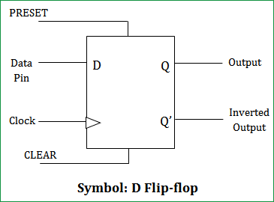
DFF
D FLIP – FLOPS ARE ALSO CALLED AS “DATA FLIP – FLOP”.
THEY ARE USED TO STORE 1 – BIT BINARY DATA. THEY ARE ONE OF THE WIDELY USED FLIP – FLOPS IN DIGITAL ELECTRONICS.

Slide 7
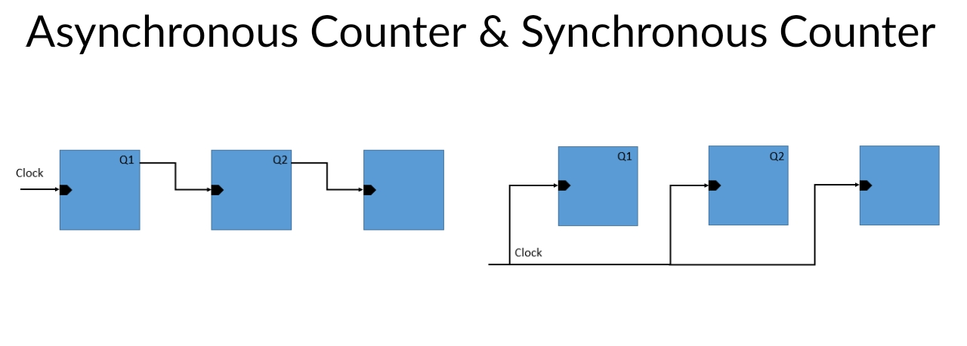
COUNTERS
A COUNTER IS A DEVICE WHICH STORES (AND SOMETIMES DISPLAYS) THE NUMBER OF TIMES A PARTICULAR EVENT OR PROCESS HAS OCCURRED, OFTEN IN RELATIONSHIP TO A CLOCK. THE MOST COMMON TYPE IS A SEQUENTIAL DIGITAL LOGIC CIRCUIT WITH AN INPUT LINE CALLED THE CLOCK AND MULTIPLE OUTPUT LINES.

Slide 8
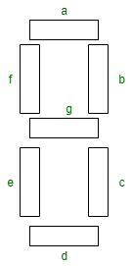
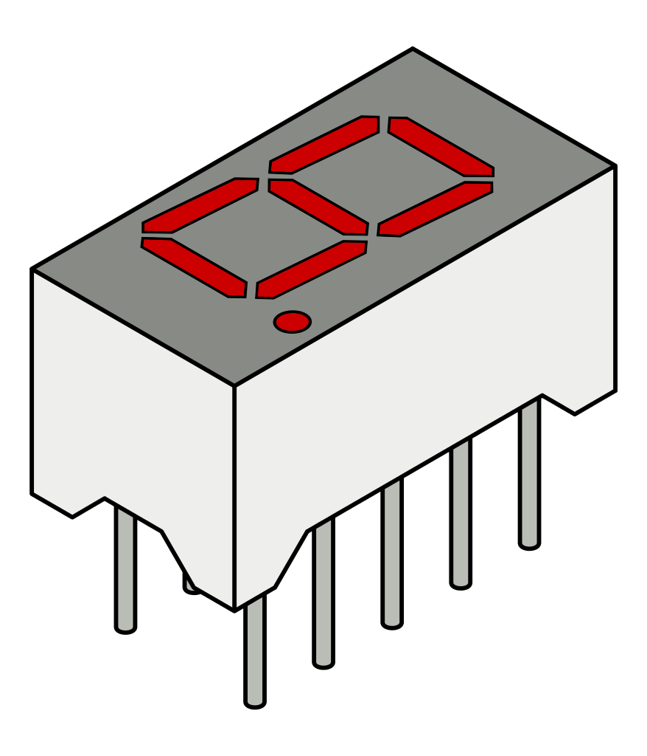
7 SEGMENT
IT IS WIDELY USED IN DIGITAL CLOCKS, BASIC CALCULATORS, ELECTRONIC METERS, AND OTHER ELECTRONIC DEVICES THAT DISPLAY NUMERICAL INFORMATION.
IT CONSISTS OF SEVEN SEGMENTS OF LIGHT EMITTING DIODES (LEDS) WHICH IS ASSEMBLED LIKE NUMERICAL 8.

Slide 9
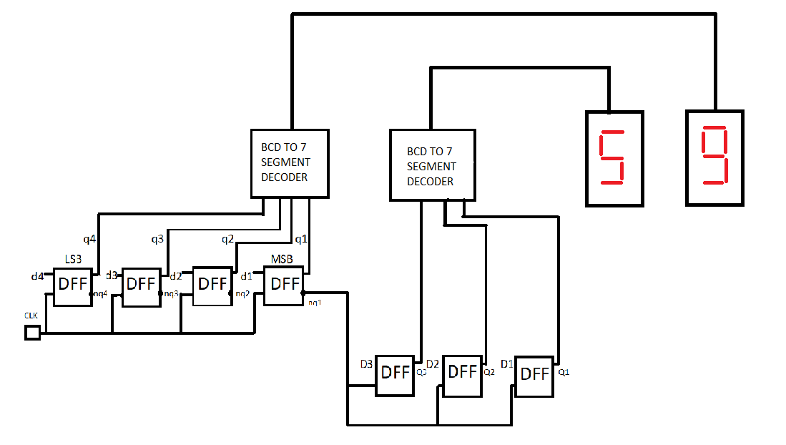
DIAGRAM OF THE DESIGN

Slide 10
DESIGN
THE MINUTE MOD-10 COUNTER IS CLOCKED BY THE NEGATION OF THE MSB OF THE MOD-6 COUNTER OF THE SECONDS. THE MOD-6 COUNTER OF THE MINUTE IS CLOCKED BY THE NEGATION OF THE MSB OF MINUTE MOD-10 COUNTER.
THE MOD-10 COUNTER REPRESENTS THE ONES PLACE OF THE SECONDS/MINUTE WHERE AS THE MOD-6 COUNTER REPRESENTS THE TENS PLACE.
SECONDS AND MINUTES EXPRESSED IN BINARY CODED DECIMAL (BCD) WHERE EACH OF THE DIGITS (UNITS AND TENS DIGIT) OF THE QUANTITIES ARE EXPRESSED IN BINARY FORM.
THE OUTPUT OF EACH OF THE COUNTERS IS FED INTO A BCD TO 7 SEGMENT DISPLAY DECODER ,THE OUTPUT OF WHICH IS UTILISED TO DISPLAY THE SECONDS AND MINUTES.
THE CLOCK IS DESIGNED FROM 14 SYNCHRONOUS D FLIP FLOPS. D FLIP FLOPS ARE USED TO CHANGE THE VALUES OF THE OUTPUT OF EACH BIT OF THE BCD CODE.

Slide 11
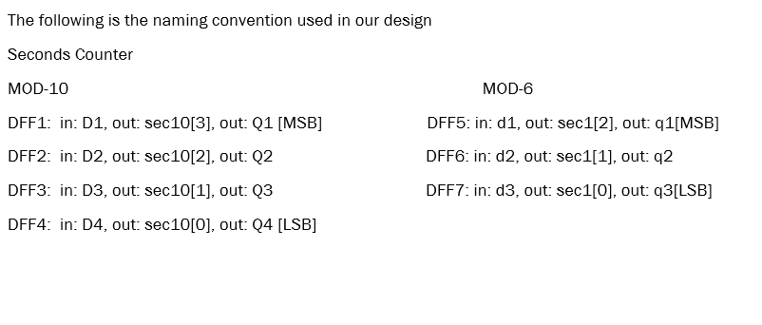
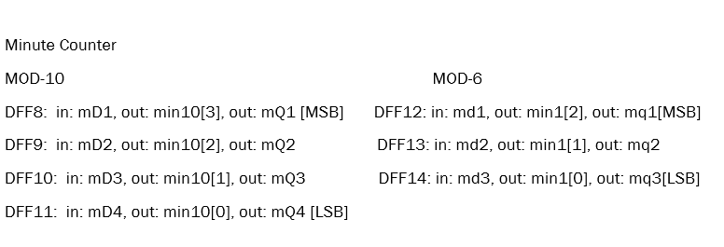

Slide 12
THE TENS DIGIT OF THE SECONDS AND MINUTES SHOULD BE CHANGED WHEN THE UNITS DIGIT GOES FROM 9 TO 0 IN THIS CASE THE MOST SIGNIFICANT BIT OF THE UNIT DIGIT GOES FROM 1 TO 0 (1001 TO 0000 ) HENCE WE CONNECT THE NEGATION OF THIS BIT TO THE CLOCK OF THE MOD-6 COUNTER WHICH GIVES THE TENS DIGIT OF SECONDS AND MINUTES,
WHEN THIS DFF IS TRIGGERED IT STARTS TO WORK AND HENCE GIVES THE BIT VALUE OF THE NUMBERS WHICH HAS BEEN REPRESENTED IN BCD .
THIS OUTPUT IS THEN FED INTO FOUR 7 SEGMENT DISPLAYS IN ORDER TO GET THE FOUR DIGITS TWO EACH OF SECONDS AND TWO EACH OF MINUTES.
WE ALSO KNOW THAT THE UNIT’S DIGIT OF MINUTE SHOULD BE INCREMENTED WHEN THE TENS DIGIT OF THE SECOND GOES FROM 5 TO 0(101 TO 000) HENCE WE CONNECT THE NEGATION OF THE MOST SIGNIFICANT BIT OF THE TEN DIGIT OF THE SECOND TO THE CLOCK OF THE UNITS DIGIT OF MINUTES
HENCE THIS CLOCK IS ALSO TRIGGERED DURING THE CORRECT TIME AND THE OUTPUT IS CALCULATED.

Slide 13
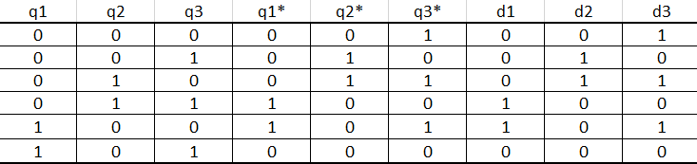
TRUTH TABLES
MOD-6 TRUTH TABLE FOR 10TH DIGIT OF SECONDS

Slide 14
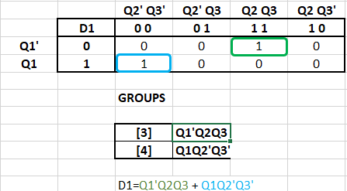
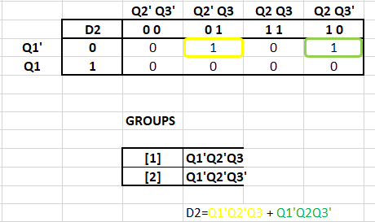
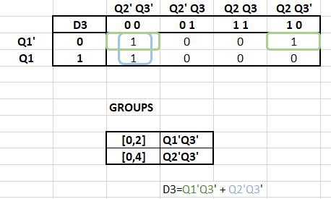
K-Maps FOR MOD-6

Slide 15
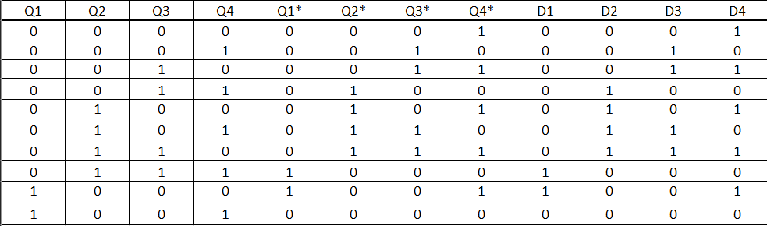
MOD-10 TRUTH TABLE FOR ONES DIGIT OF SECONDS

Slide 16
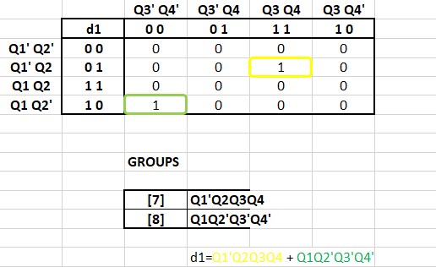
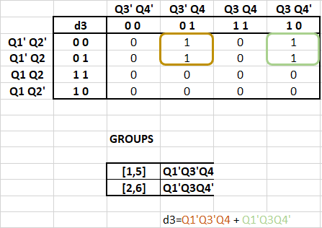
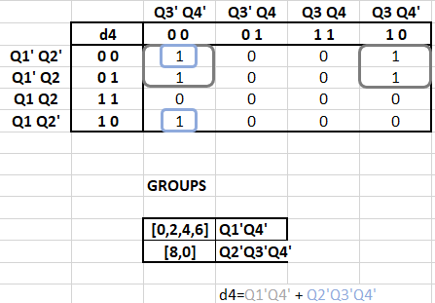
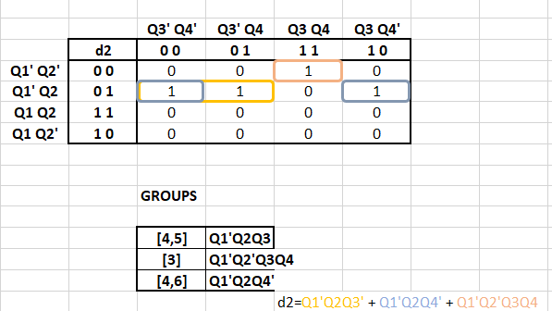
K-MAPS FOR MOD-10

Slide 17
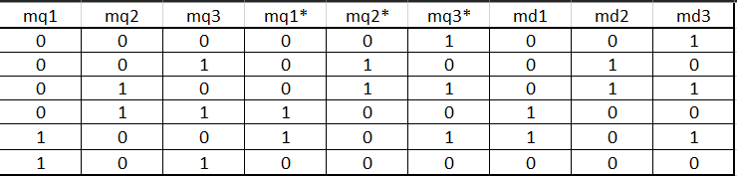
MOD-6 TRUTH TABLE FOR 10TH DIGIT OF MINUTE

Slide 18
K-Maps FOR MOD-6

Slide 19
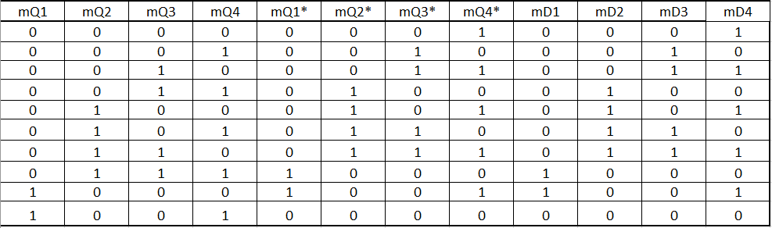
MOD-10 TRUTH TABLE FOR ONES DIGIT OF MINUTE

Slide 20
K-MAPS FOR MOD-10

Slide 21
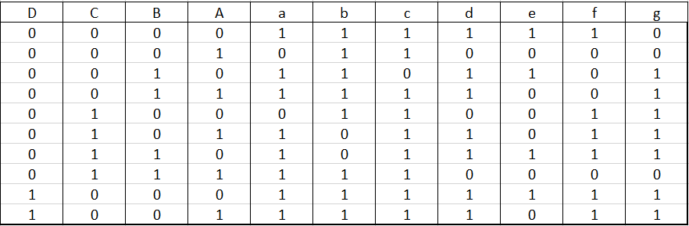
TRUTH TABLE FOR BCD TO 7 SEGMENT

Slide 22
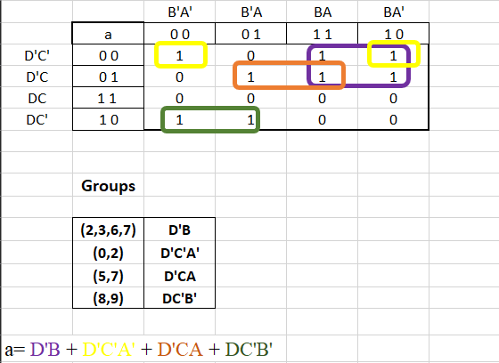
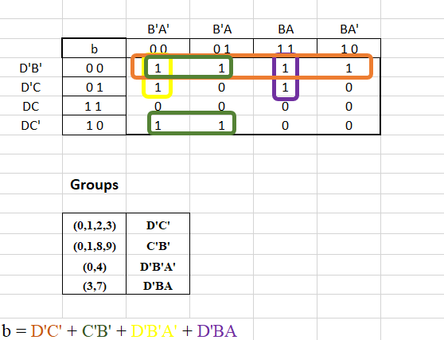
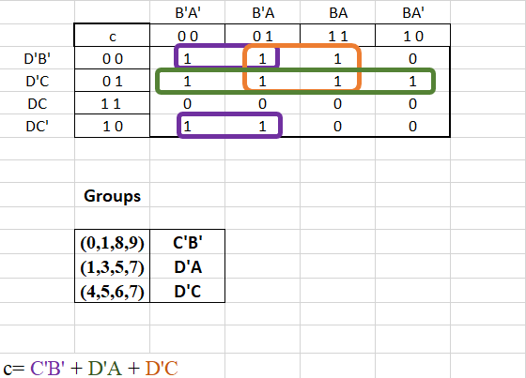
K-Maps FOR BCD TO 7 SEGMENT
BCD TO 7 SEGMENT

Slide 23
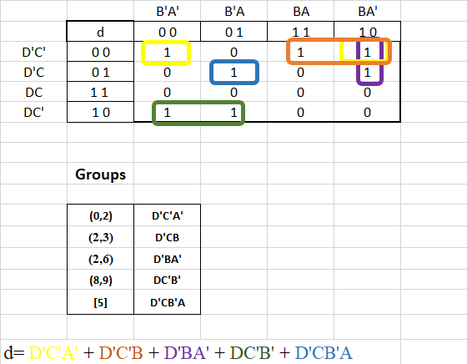
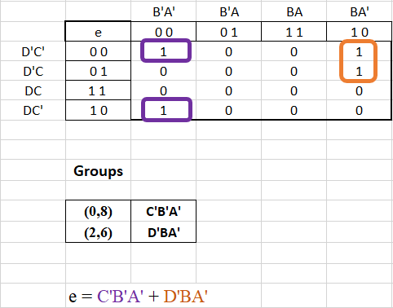
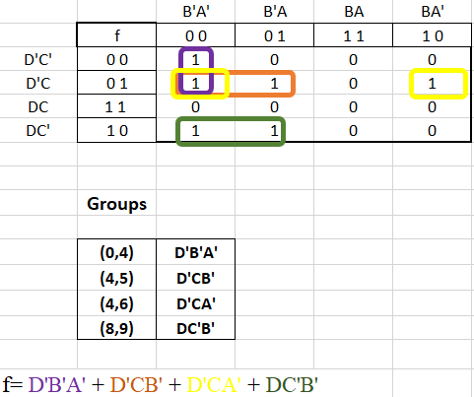

Slide 24
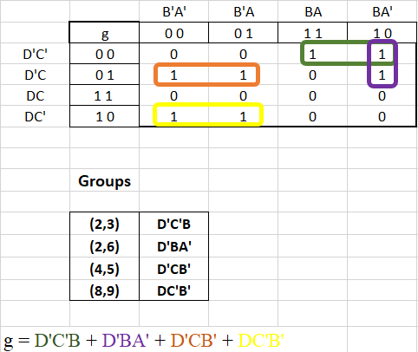

Slide 25
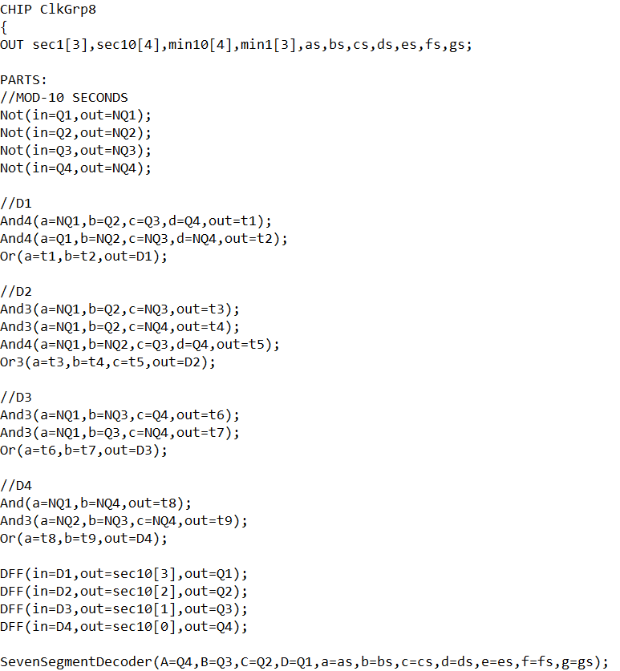
HDL IMPLEMENTATION

Slide 26
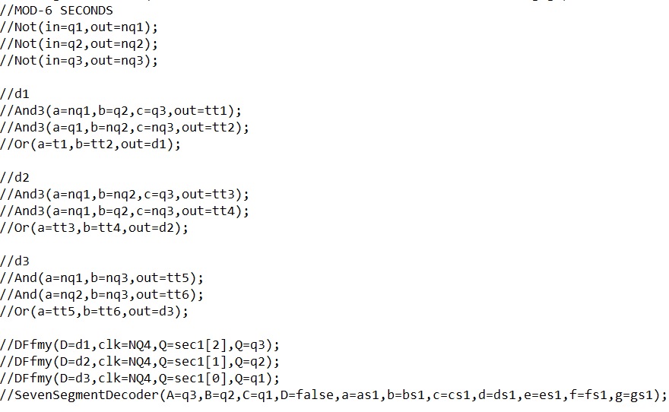
MOD-6 COUNTER FOR SECONDS

Slide 27
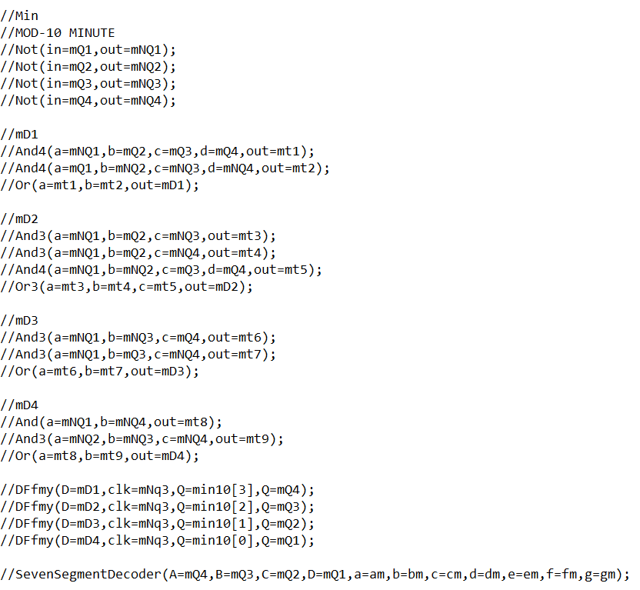
MOD-10 COUNTER FOR MINUTE

Slide 28
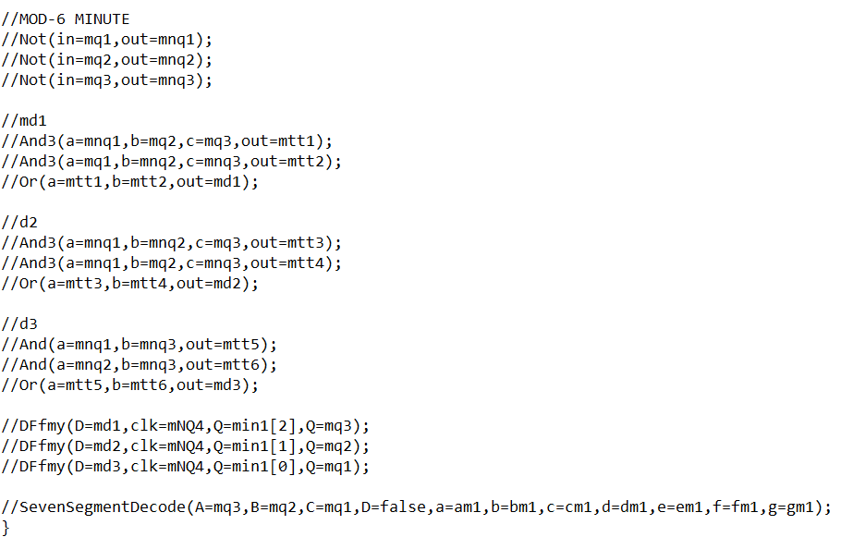
MOD-6 COUNTER FOR MINUTE

Slide 29
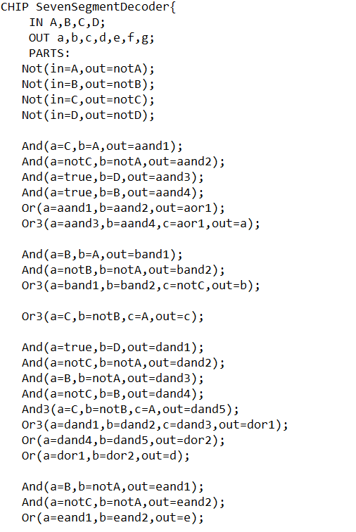
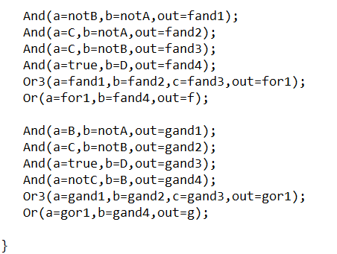
BCD TO 7 SEGMENT

Slide 30
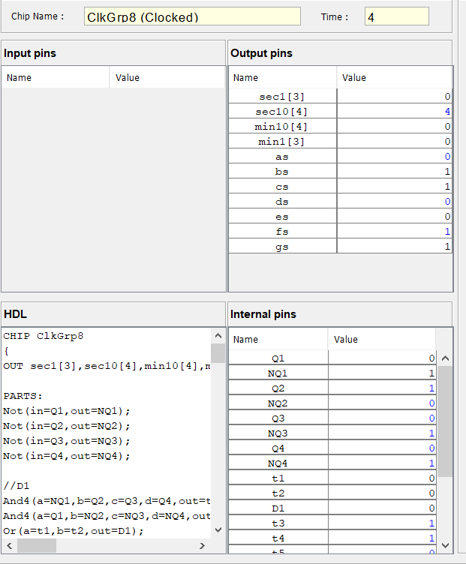
OUTPUT IN HDL

Slide 31
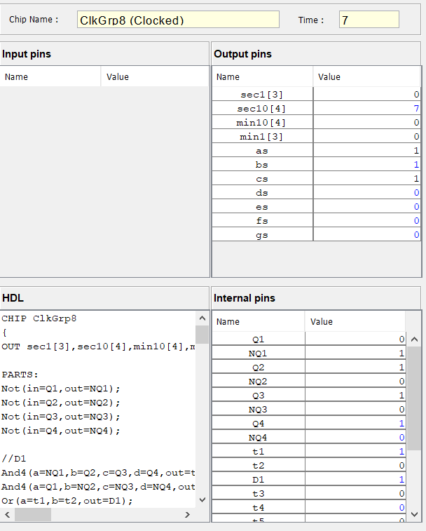

Slide 32
CHALLENGES AND DIFFICULTIES FACED
DURING THE DESIGN OF A MOD-6 COUNTER FOR DISPLAYING THE SECONDS AFTER 9 THE DFF OF THE MOD 6 COUNTER HAS TO GET TRIGGERED ONLY WHEN THE MOD-10 COUNTER GOES FROM 9 TO 0 (1001 TO 0000) .
IN THE NAND2TETRIS PLATFORM THE DFF IS CLOCKED AUTOMATICALLY BY THE SYSTEM AND HENCE THE MOD-6 COUNTER DESIGNED WITH THE SAME DFF COUNTS AFTER EVERY TICK-TOCK.
IN THIS CASE WE WANT THE COUNTER TO COUNT ONLY WHEN THE MOD-10 COUNTER GOES FROM 9 TO 0 (1001 TO 0000). THIS CAN BE ACHIEVED BY BUILDING A DFF USING NAND GATES AND CLOCKING IT MANUALLY.
IN NAND2TETRIS SOFTWARE SUITE

Slide 33
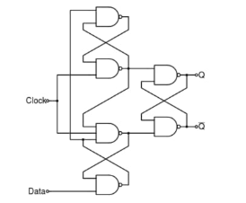
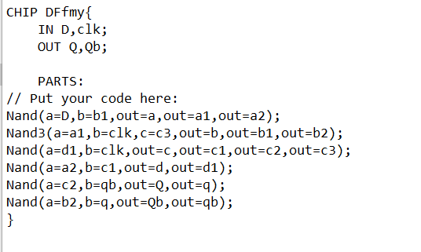

Slide 34
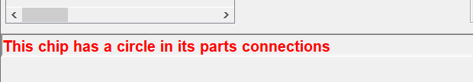
DURING THE LOADING OF THE CHIP DFfMY THE HARDWARE SIMULATOR THREW AN ERROR “THE CHIP HAS CIRCLE IN ITS PARTS CONNECTION.”
THE ABOVE CIRCUIT WAS NOT LOADING IN NAND2TETRIS EVEN AFTER REPEATED ATTEMPTS TO APPEND THE OUTPUT/INTERNAL PINS.
HENCE THE MOD-6 (TENS DIDGIT) SECOND COUNTER AND THE MOD-10 , MOD-6 MINUTE COUNTER WAS NOT LOADING FOR THE DESIGN DEPENDS ON THE DFF THAT HAS BEEN CREATED.
THEREBY THE OUTPUT IN THE HACK PLATFORM HAS NOT BEEN SHOWN AFTER 9 SECONDS.

Slide 35
DESIGN IN CIRCUITVERSE
USING THE EXPRESSIONS OBTAINED AFTER SIMPLIFYING THE KMAPS ,WE DESIGNED THE MOD-6, MOD-10 COUNTERS IN THE ONLINE PLATFORM USING INBUILT AND, OR, NOT GATES AND DFF.
THE OUTPUTS OF THE MOD-10, MOD-6 COUNTERS WERE FED INTO A BCD TO 7 SEGMENT DECODER AND THEREBY THE OUTPUT FROM THE DECODER IS CONNECTED TO THE RESPECTIVE PINS OF THE DISPLAY.

Slide 36
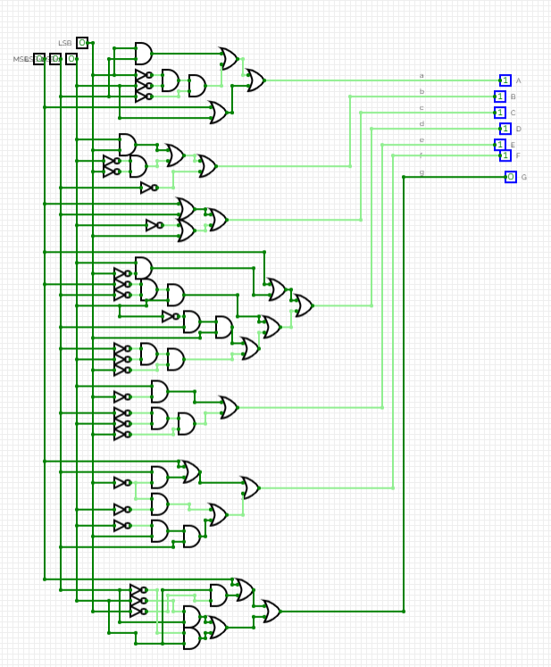
BCD TO SEVEN SEGMENT DISPLAY

Slide 37
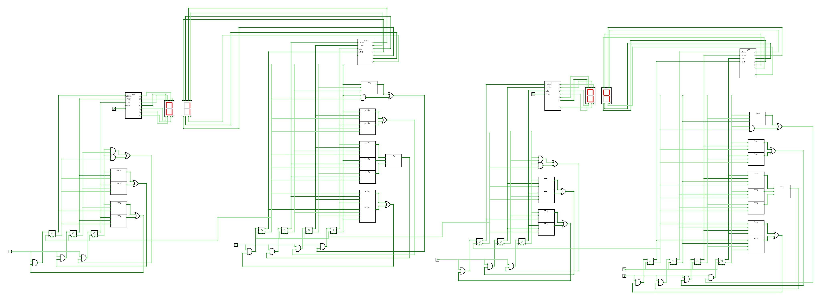
RESULT

Slide 38
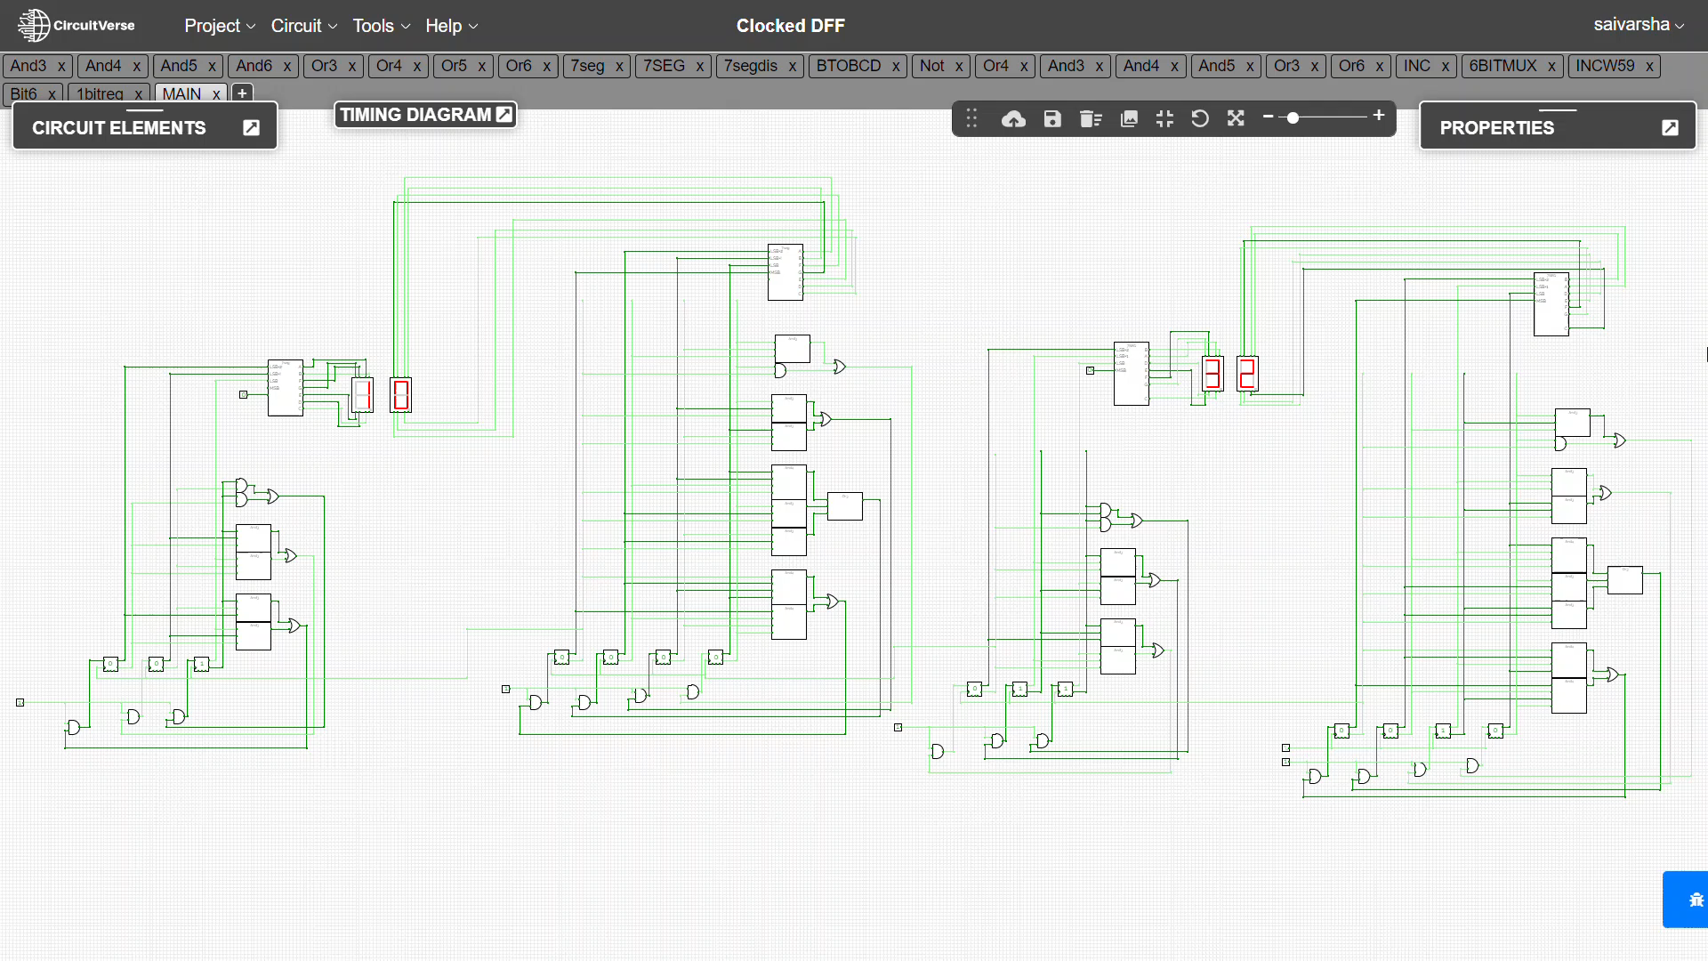

Slide 39
CONCLUSION
THUS, THIS IS HOW WE CAN DESIGN A CIRCUIT WHICH DISPLAYS UPTO 59 MINUTES USING COUNTERS AND FLIP FLOPS IN NAND2TETRIS AND CIRCUITVERSE.

Slide 40
REFERENCE
NOAM NISAN AND SHIMON SCHOCKEN BOOK
WIKIPEDIA

Slide 41
THANK YOU

